Slide 1
Chemistry Product Analysis
Emmanuel Duarte;
Former Lab Manager/Data Analyst

Slide 2
AGENDA
Introduction
Description of analysis tools utilized/Logic throughout Process
Code Examples
Charts/Graphs
Summary

Slide 3
INTRODUCTION
For my Capstone Project I reached out to my previous employer "Chemistry" and received all the Quality Control(QC) analytical tests / Certificate of Analysis (COA) test results for every product manufactured during the time the company has been active. Chemistry is a cannabis extraction company and during my time there I was the lab manager and the person in charge of the QC at every step of production, from intake to final product.
These tests show a range of results for Flower, Tinctures, Various Edibles, Vapor Cartridges(Live Resin and FSO(Full Spectrum Oil)), Cannabis Powder (for pressing pills), and Distillate (Isolated d9THC).
As a part of this report, I've been in contact with the CEO and Marketing director to answer some interesting Marketing questions and see if there has been something hiding in this data. Chemistry based their niche in the market on something called Full-Spectrum; the claim is that its oil is the best representation of the "flower" in a concentrated form. This has to do with the solvents used and a relatively simple refinement process that allows for the retention of various cannabinoids (active chemicals found in Cannabis and Hemp e.g., THC, CBD, THCA, CBDA, CBG, THCV,CBN just to name a few) and terpenes.
There are 14 cannabinoids that analytical labs test for although there are people still discovering new compounds as well as synthesizing them in a lab setting. Cannabis/Hemp also contain Essential oils that we refer to as Terpenes. Terpenes influence the medicinal effect and give the flower its aroma and when smoked its flavor. Cannabinoids and terpenes are going to be the focus of this analysis.
I've been given the task to compare the ratios of these two groups of compounds from their flower form to their concentrated form in order to prove exactly how “True to the Plant" their products are. I'll try my best to explain the analysis process as it pertains to this somewhat esoteric data.

Slide 4
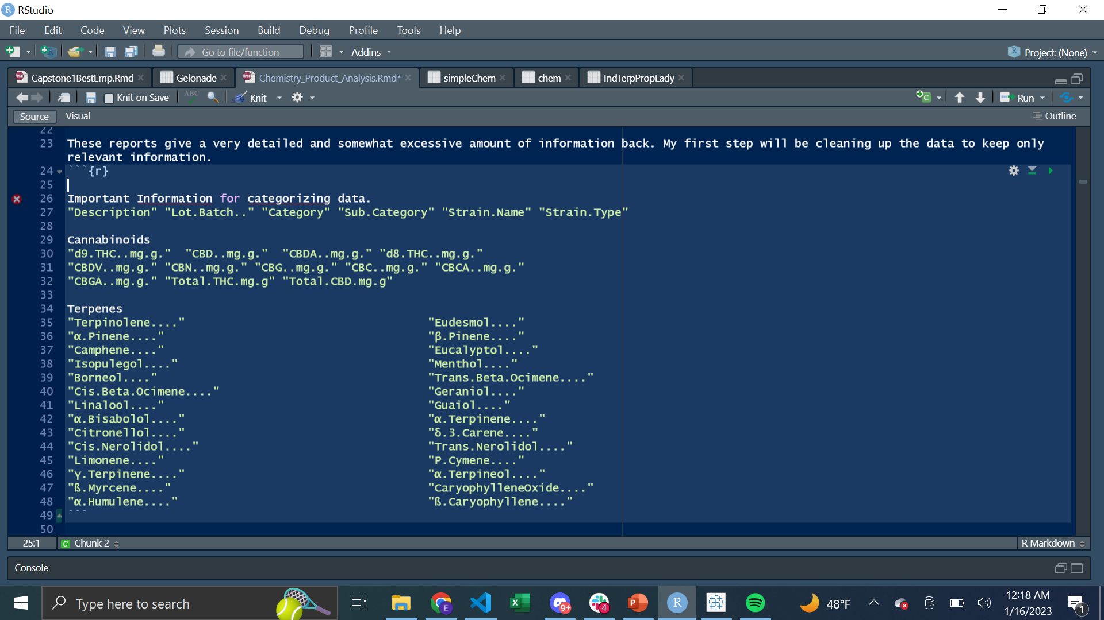
Analysis tools Utilized/Logic
For this report; I will be implementing techniques learned over the Coding Temple course. The two programs I’ve used to extrapolate the data are R Studio and Python Pandas/ Matplotlib.
The data shared with me was raw. There were over 400 columns and 800 rows. Most of these rows were empty or had “ND”, NaN or “BLOQ” values. An important step in the process was deciding what data would be useful, and how to properly filter it.
To the left are the columns filtered into the simpler database.
After keeping these columns and removing non-numeric data I created two extra columns with the sums of the cannabinoids(mg/g) and terpenes(mg/g).
In order to answer the question of if the products are a close representation of the starting material, I needed to find the proportion of cannabinoids and terpenes (each individual cannabinoid and terpene divided by the total per strain.)

Slide 5
Analysis tools Utilized/Logic
The strains that I did this analysis with are only the ones that had a QC test of the starting material before it was processed into an oil.
I went through the database and searched for all the “Flower” Test results that had either a cannabinoid or terpene analysis.
These are the strains I was able to do the analysis on.
Cannabinoids and Terpenes- Jack Herrer, Lady Benbow, Pineapple Wonder, Royal Cherry Kush, Strawberry Banana Live, Super Lemon Haze Live, XJ13, ACDC
Cannabinoids Only- Gelonade, Lemon Mac, Orange Durban, Strawnana Frosting, Apricot Trainwreck, Jungle Pound Cake.
Fresh vs Cured Terpenes-Gas and Roses

Slide 6
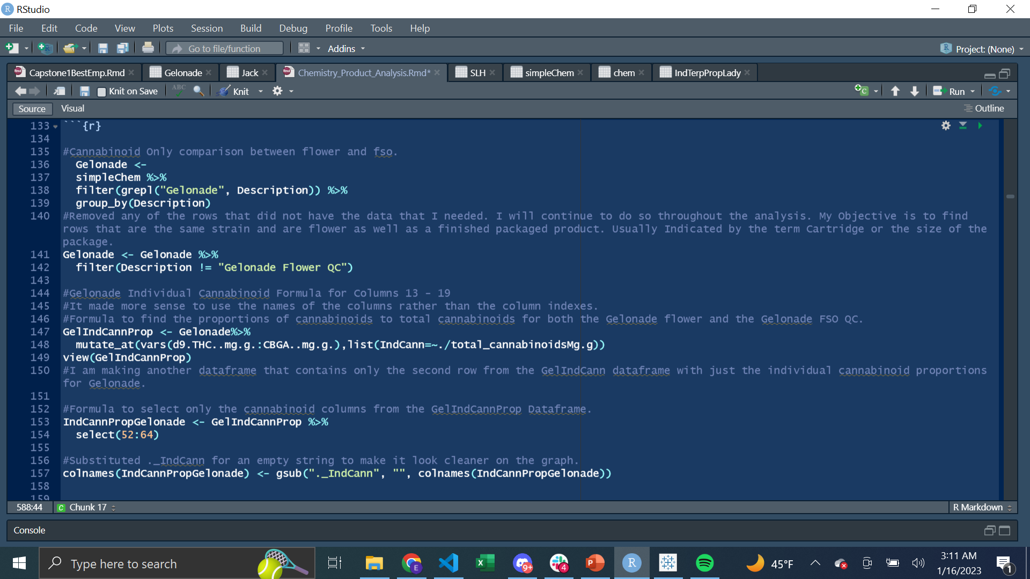
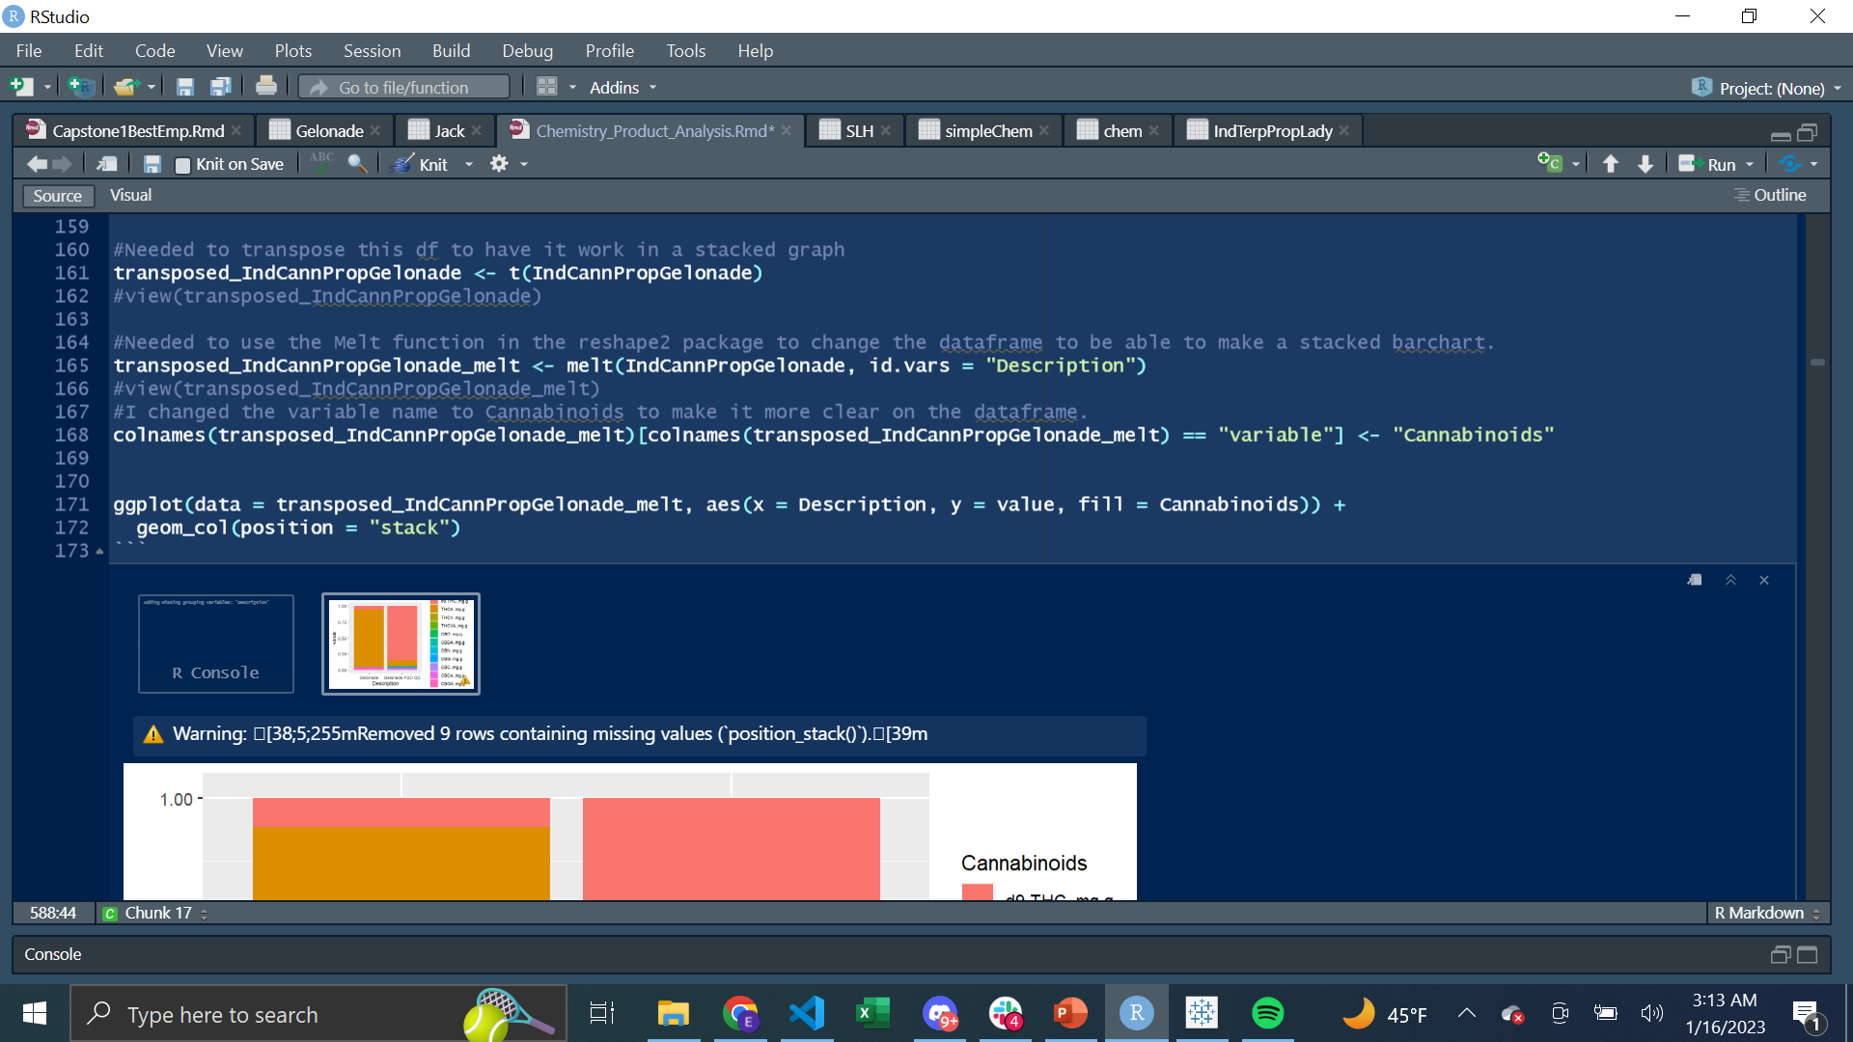
R Studio-Code Example
To the left we have an example of the code used to make the database and manipulate it to work as a stacked bar chart.

Slide 7
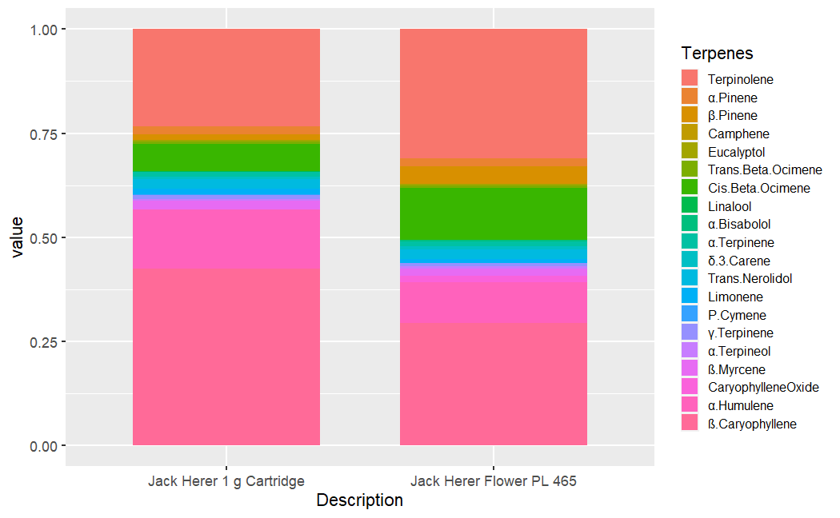
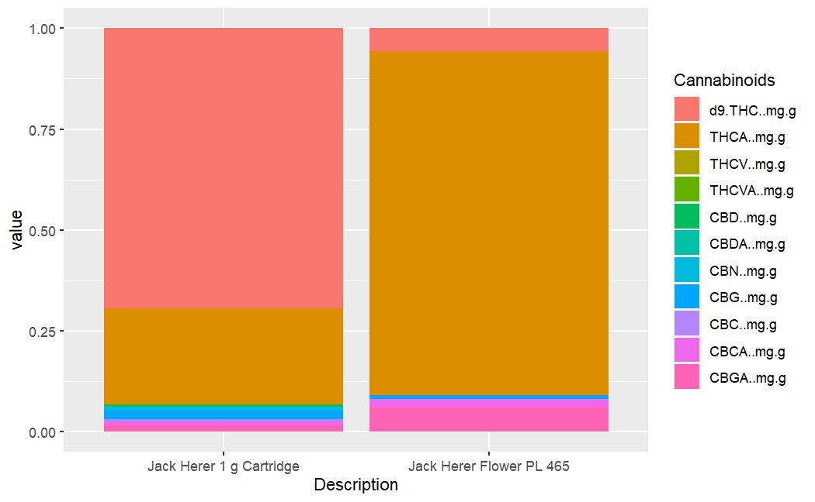
Charts & Graphs
Jack Herer
We’ll start with a classic strain “Jack Herer”. One important thing to mention, in the cannabinoid comparison is that the flower form will always contain more THCA. For the less cannabis savvy viewing the presentation, THCA is simply the acidic precursor to delta 9 THC (the most popular cannabinoid). When making an oil as a part of removing all residual solvents there is significant heat required that decarboxylates (activates) acidic (raw) cannabinoids. For the purposes of this analysis, it would be easiest to lump d9.THC..mg.g with THCA..mg.g.
In the terpene analysis it will be generally stated that there will most likely always be more ß.Caryophyllene in the extract compared to the flower. This is a very molecularly “heavy” terpene and unless the terpene infusion rate is very high will stick out more in the extract than in the flower. I would be happy to elaborate more if someone is interested, but this topic can get rather complicated to the layman.

Slide 8
Charts & Graphs
Jack Herer
In the terpene slide we see more ß.Caryophyllene in the extract compared to the flower as expected, but the proportions of all the other terpenes are very similar to the extract! This is indicative of a solid steam distillation, and storage of the terpenes as well as a good infusion rate!
In the cannabinoids the higher proportion of CBG in the extract compared to the flower is due to the activation during the purge process. All around, this is an excellent representation of the flower in extract form.

Slide 9
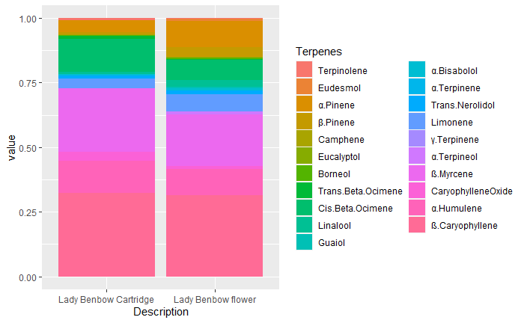
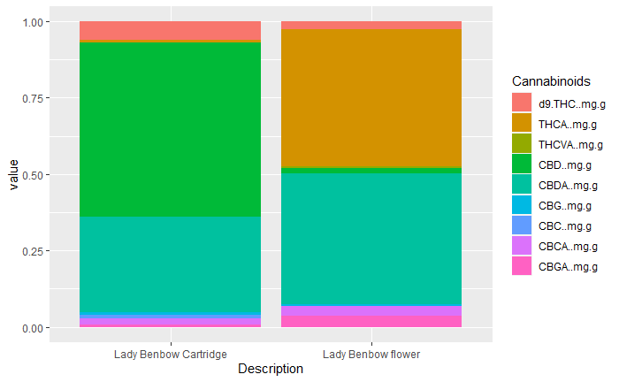
Charts & Graphs
Lady Benbow
The Chemistry brand has always been a proud proponent of cannabis as medicine. It is very well known for it’s CBD extracts for their effects and their taste/smell. The Lady Benbow Cartridge is one of the strains that won 1st place at the Emerald Cup (One of the most important cannabis cups in California) in the CBD category.
Again, we see an excellent representation of the flower expressed in extract form both in cannabinoids and terpenes.

Slide 10
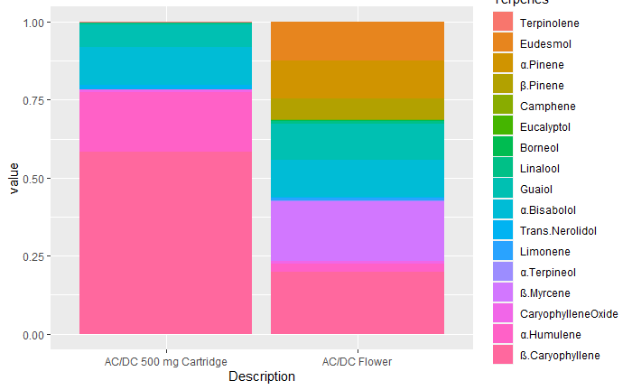
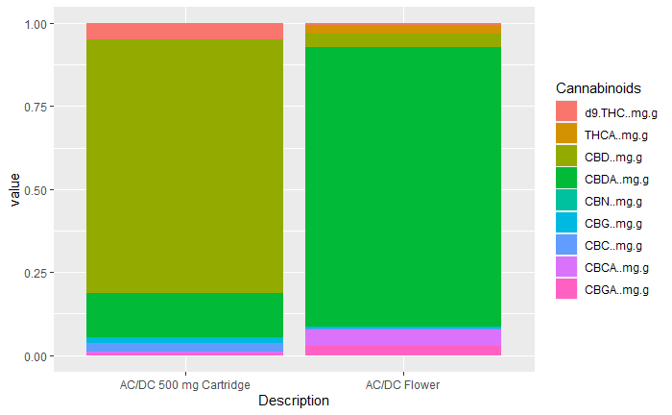
AC/DC
Charts & Graphs
Another incredible CBD strain known for its healing properties is AC/DC. I wanted to give an example of perhaps a mix up in the data or a problem with the infusion.
There are complete blocks of terpenes missing from concentrate to the flower form. These were the only two terpene results I found in the database, but AC/DC is a strain that was ran many many times. The flower tested could have come from a different farm. Gown and post processed in completely different ways and I only received the results of the data without any details to go by.
The cannabinoid proportions seem fairly consistent.

Slide 11
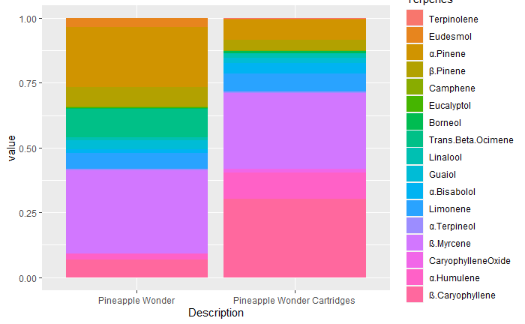
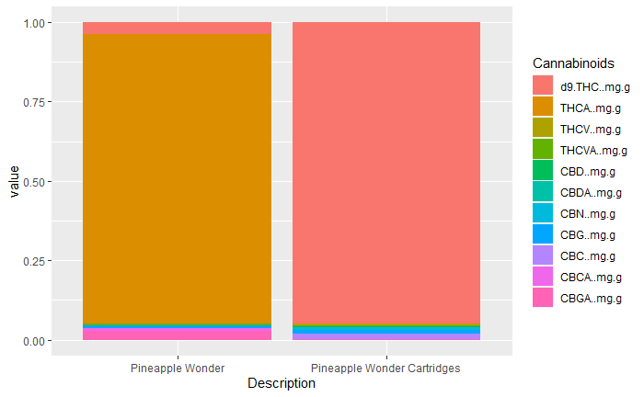
Pineapple wonder
Charts & Graphs
The smell I got from Pineapple wonder was incredible. It was intensely sweet and floral.
The extract on the other hand was good but lacked that intense sweetness.
Looking at the terpene graph it seems a higher infusion rate would have been able to fix this.
In the cart, the combination of Beta Caryophyllene (Black Pepper) and Humulene(Hops) that made up a major component of the extract took over its profile leaving the other “lighter” terpenes normally found in the flower unable to shine through.

Slide 12
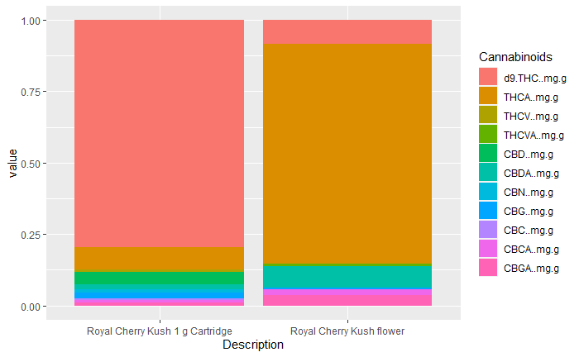
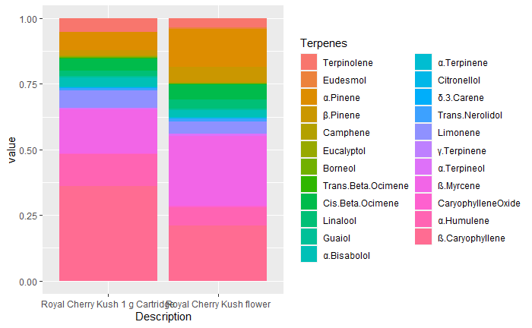
Charts & Graphs
Royal Cherry Kush
The proportions for both cannabinoids and terpenes in the Royal Cherry Kush.
Again, we see an excellent representation of the flower expressed in extract form both in cannabinoids and terpenes.

Slide 13
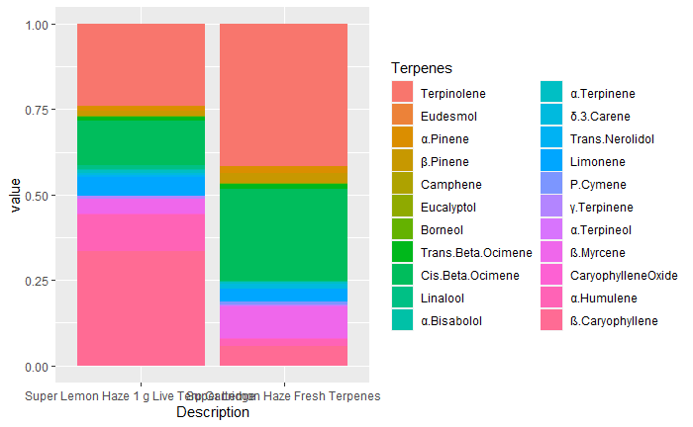
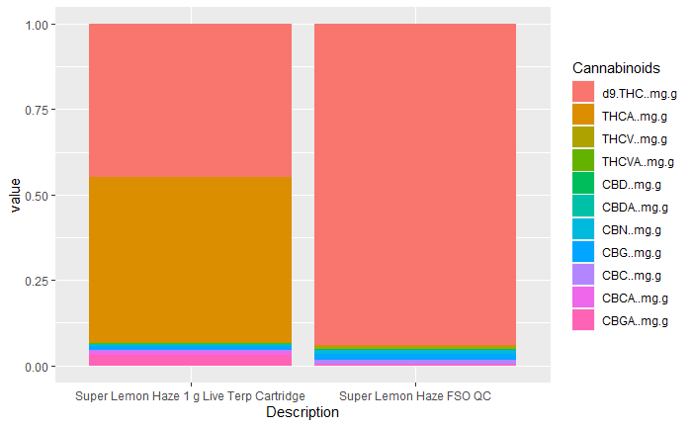
Charts & Graphs
Super Lemon Haze Live Resin
The following strains will be a comparison of “Live” terpenes, distilled on the farms from fresh flowers. They will have higher proportions of “lighter” terpenes that are usually not found in cured flower due to oxidation and the volatility of these compounds. The extraction was done on cured flower which is why the proportions might not be exact.
The cannabinoid results remains consistent.

Slide 14
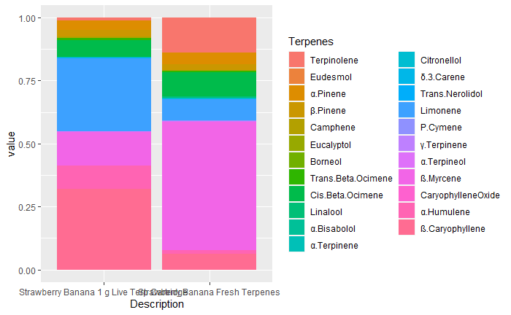
Strawberry banana Live Resin
Charts & Graphs
Without any test results for the actual flower, what we have here to compare are the Live terpenes from the fresh flower and the same terpenes reinfused with the terpenes left after the extraction and purge process.
All the same terpenes are present, but the proportions are off due to the previous explanations.

Slide 15
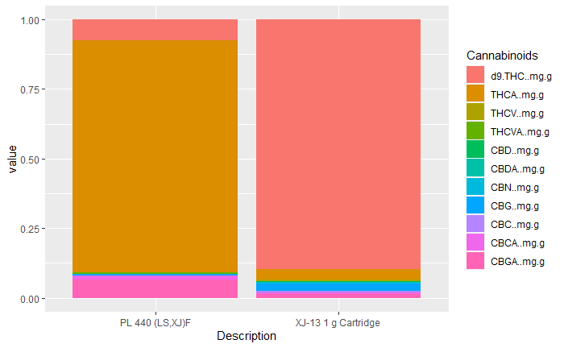
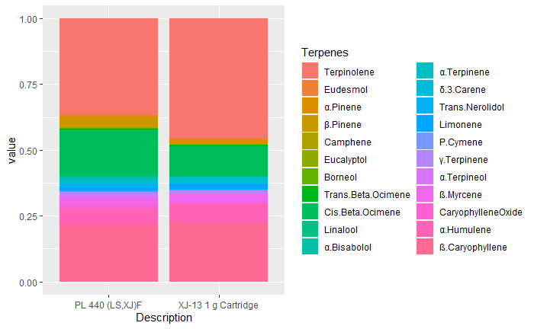
XJ-13
Charts & Graphs
With one of the highest terpene infusion rates of any of the Chemistry products, the XJ13 really was the true flower experience. Due to the high infusion the overall cannabinoid percentages were low, but this cart packed an intense punch of flavor.
We can see the terpene proportions are almost exactly like the flower and the cannabinoids as well.

Slide 16
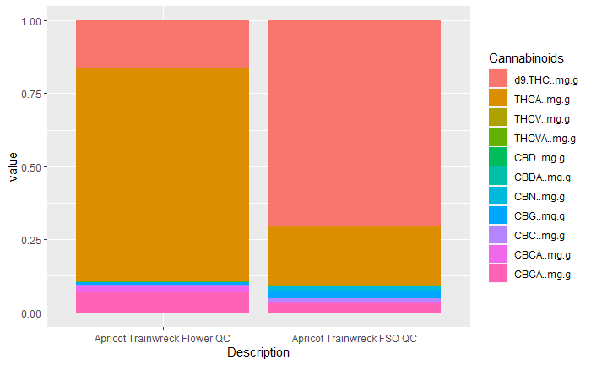

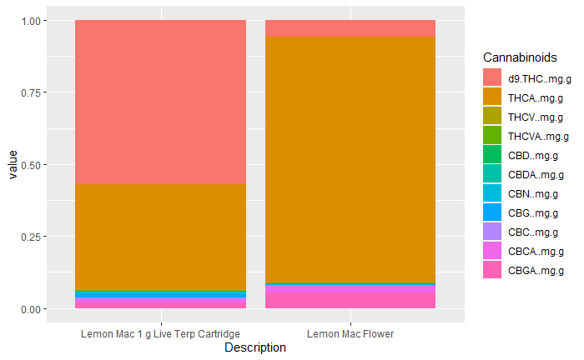
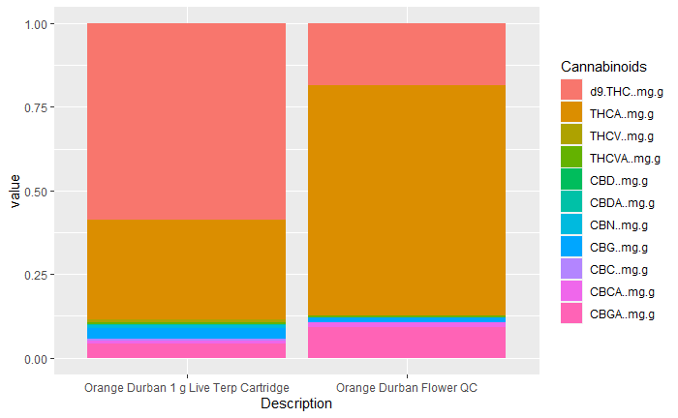
Charts & Graphs
Cannabinoids Only
For this group of comparison, the only tests that were done were for cannabinoids. Since most of the strains are THC driven it is difficult to look at the nuances between cannabinoids. Here we have Apricot Trainwreck, Gelonade, Lemon Mac and Orange Durban.

Slide 17
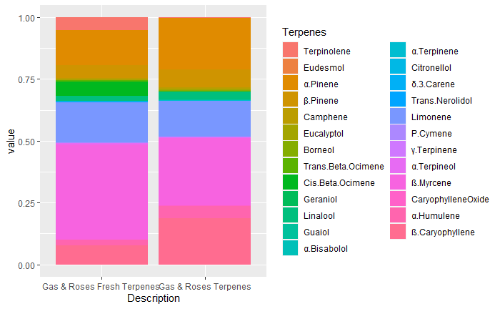
Charts & Graphs
Gas & Roses Terpene Comparison
The final comparison chart is the only example of comparing freshly harvested terpenes to cured terpenes. These are samples of the essential oils themselves not the flower.
Terpinolene and Borneol are not detectable in the cured sample where there is also a significantly higher presence of beta caryophyllene. The fresh terpenes also have a more notable presence of beta myrcene (mangoes) than the cured.

Slide 18
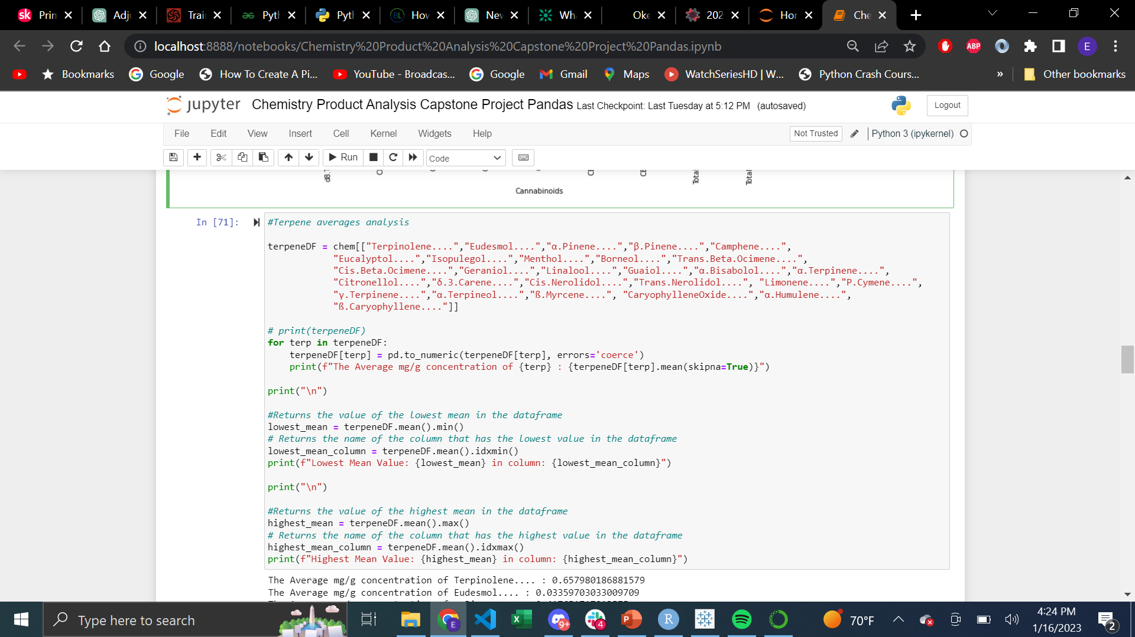
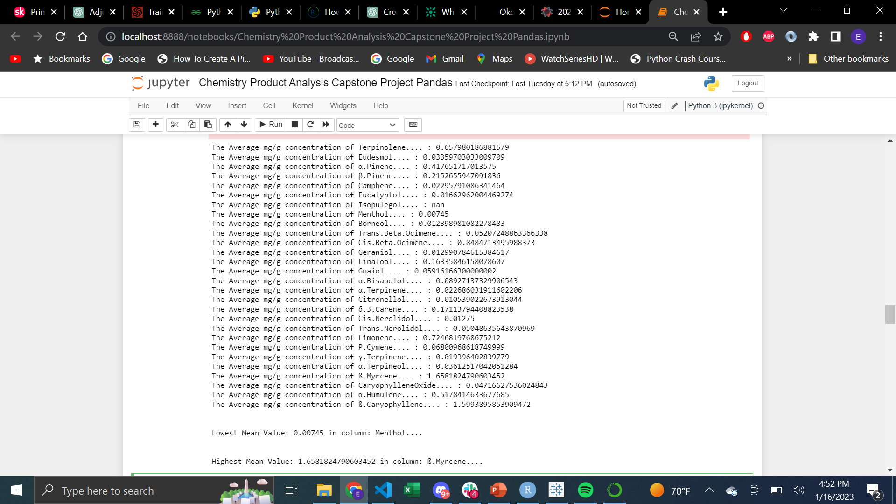
Python Pandas-Code example
To the left is an example of the Pandas code used to find the mean concentration of terpenes for all the individual samples.
The code also looks for the terpene with the highest and lowest concentration. Below is the output.

Slide 19
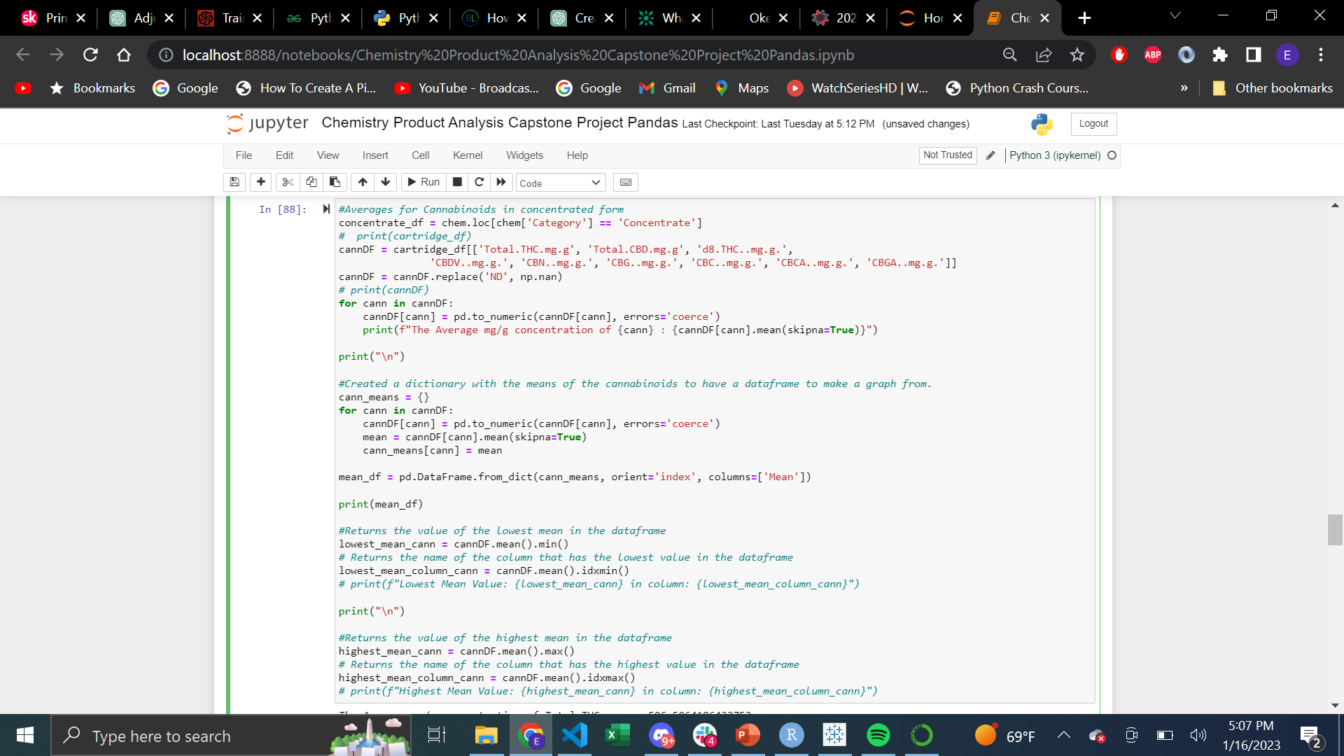
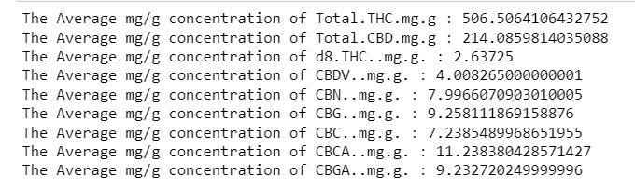

Python Pandas-Code example
To the left is an example of the Pandas code used to find the mean concentration of cannabinoids for all the individual samples.
The code also looks for the cannabinoids with the highest and lowest concentration. Below is the output.

Slide 20
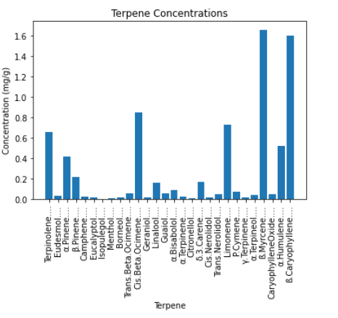
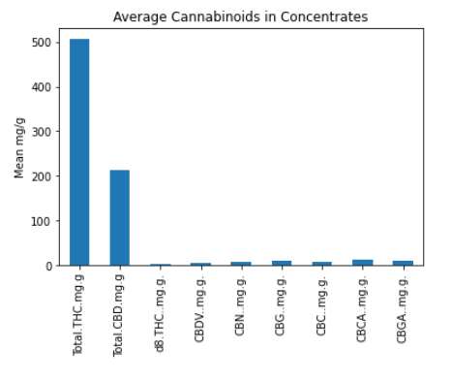
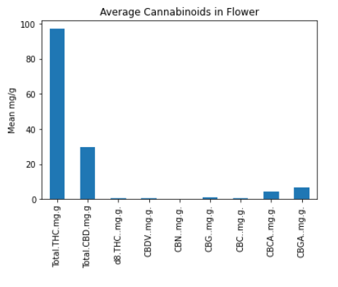
Python/Pandas Charts and graphs
Below are the charts made using the Matplotlib Python library with Numpy showing the average cannabinoids by concentrates/flower and the mean terpene content.
The averages I would say are low, but this should be because there are many samples sent out that were not of final products (for concentrates) and there are “Plant” samples with very small quantities of cannabinoids that can skew these results to the lower end.

Slide 21
SUMMARY
In conclusion, this analysis was able to paint a colorful picture showing the wide array of samples and their variance. It demonstrated a clear capacity of the company to create products that are “True to the plant”.
With the samples that were available to be analyzed the proportions of terpenes in the concentrates were very similar to those of the plant, and cannabinoids was an even closer representation.
With this holistic message in mind, and with the background knowledge I have of the complete extraction process; I am proud to have been a part of this company's ethos and here is to the hope that the message is able to grow past the idea that this small cannabis company has.
I am hopeful that this message will spread well, and consumers will continue to appreciate the thoughtfulness behind these products.

Slide 22
THANK YOU
For any questions or comments please feel free to reach out to:
Emmanuel Duarte
Emmanuel.Duarte9@gmail.com
(786) 234-4614

